Slide 1

Objects and methods
CSC 113: Computer programming II

Slide 2
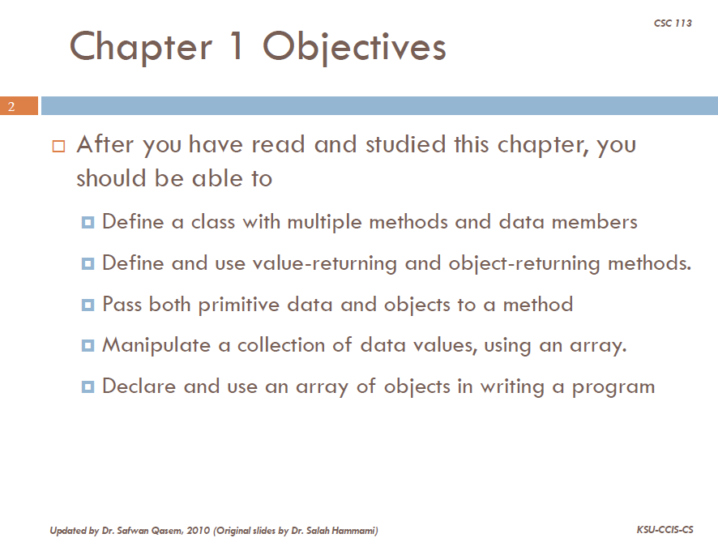

Slide 3
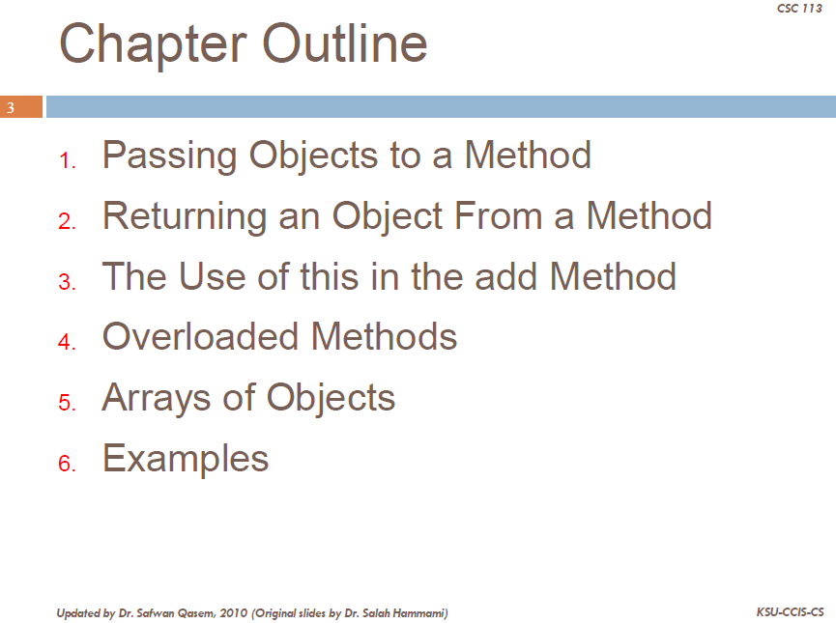

Slide 4
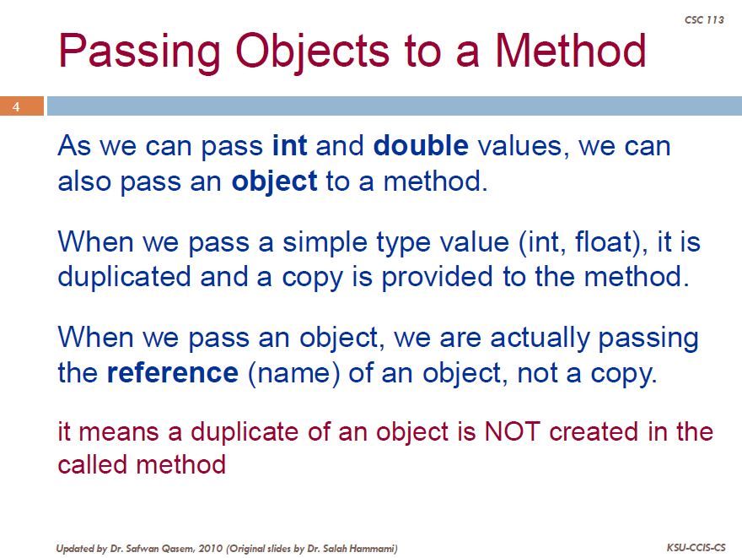

Slide 5
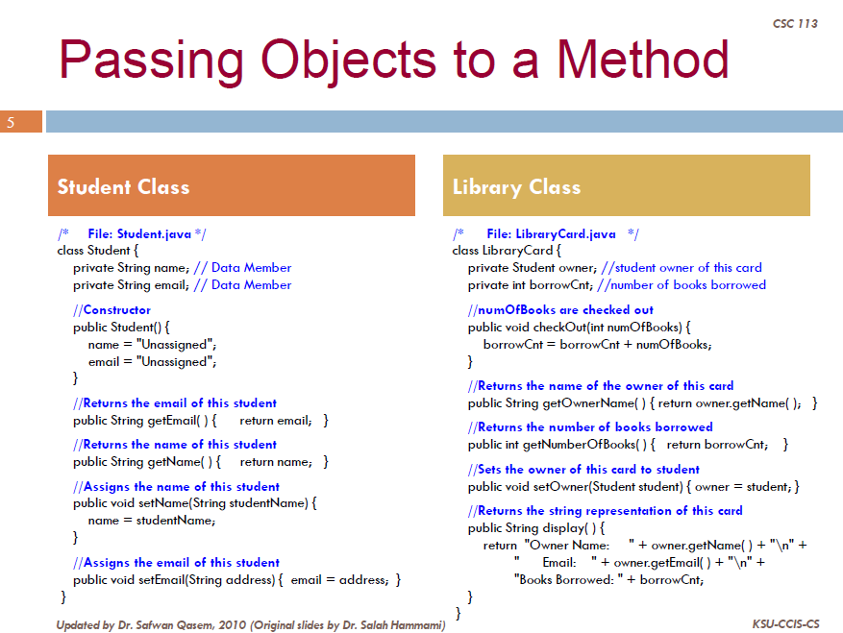

Slide 6
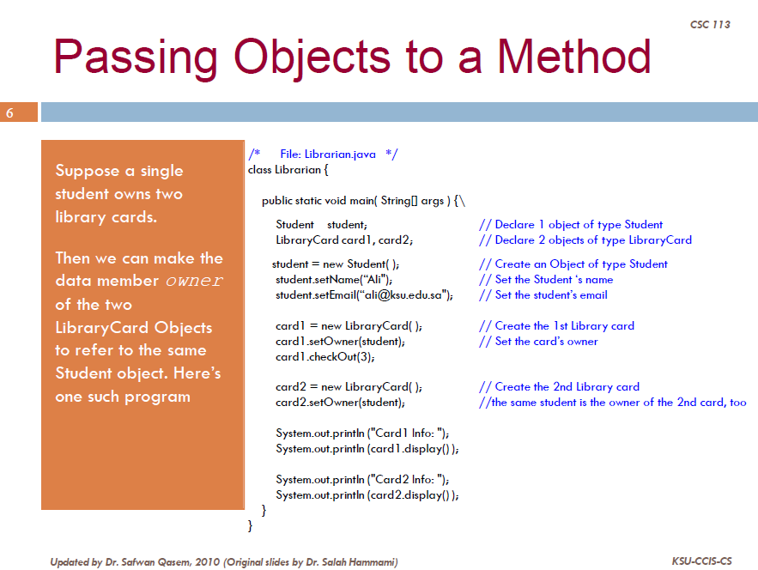
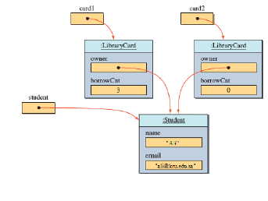

Slide 7
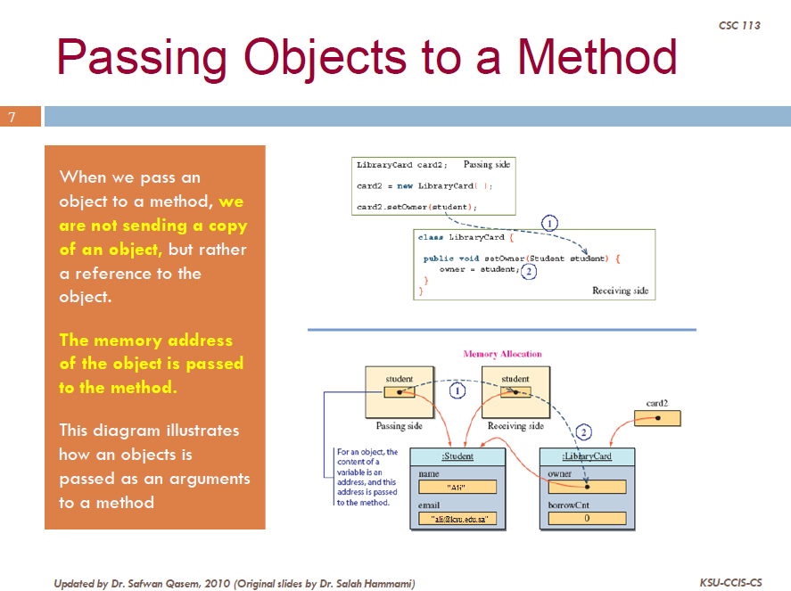

Slide 8
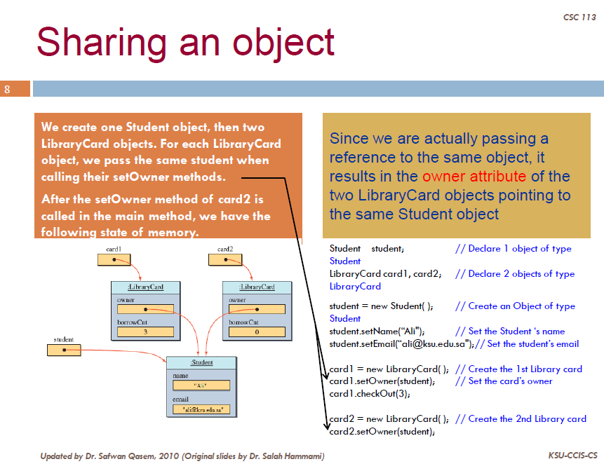

Slide 9
The Method toString
public value-returning method
Takes no parameters
Returns address of a String object
Output using print, println, printf methods
Default definition creates String with name of object’s class name followed by hash code of object

Slide 10
The Method toString
Implementing toString method in java is done by overriding the Object’s toString method.
The java toString() method is used when we need a string representation of an object.
It is defined in Object class.
This method can be overridden to customize the String representation of the Object.

Slide 11
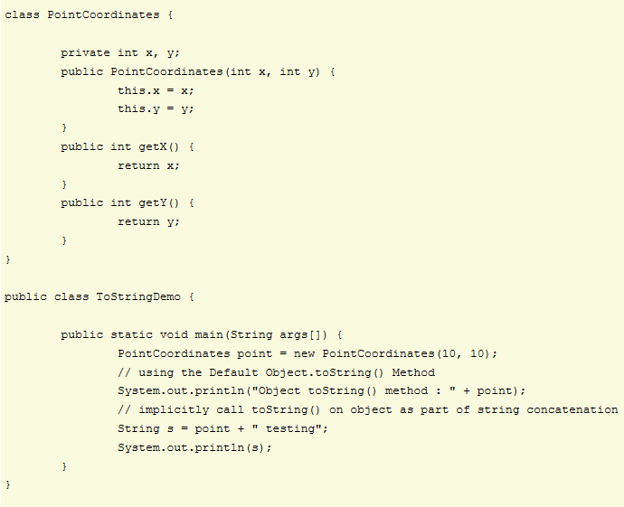
Object toString() method : PointCoordinates@119c082 PointCoordinates@119c082 testing

Slide 12
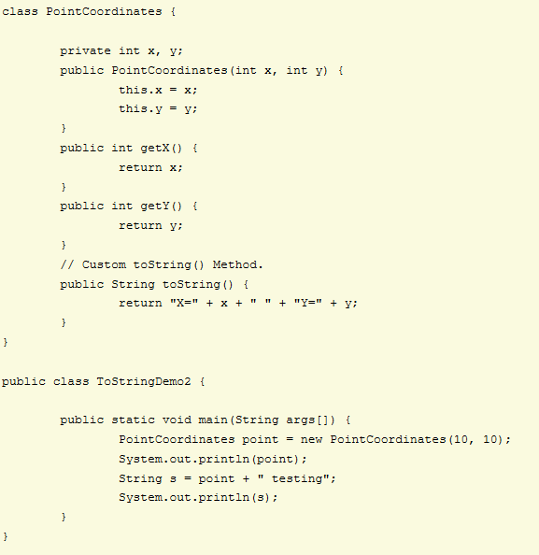
When you run the ToStringDemo2 program, the output is:
X=10 Y=10 X=10 Y=10 testing

Slide 13
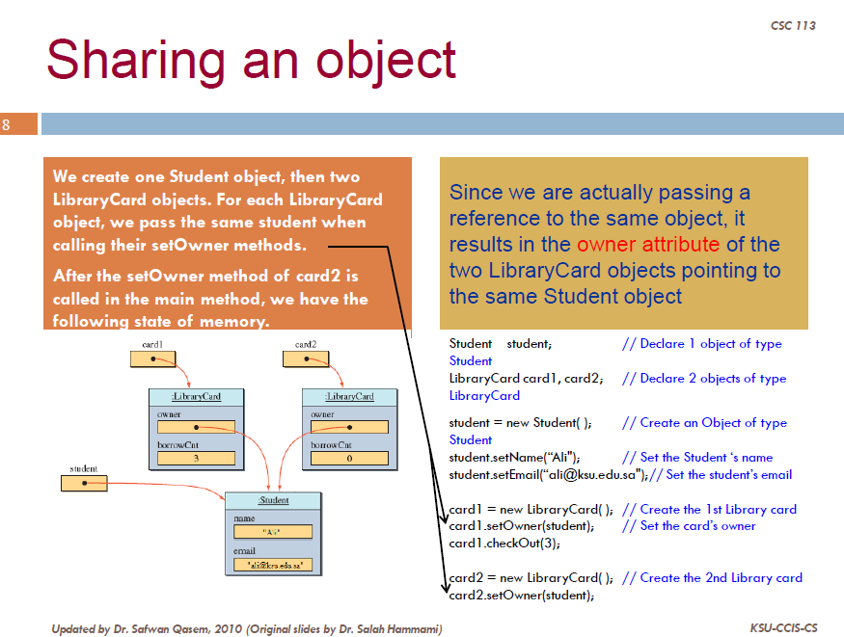
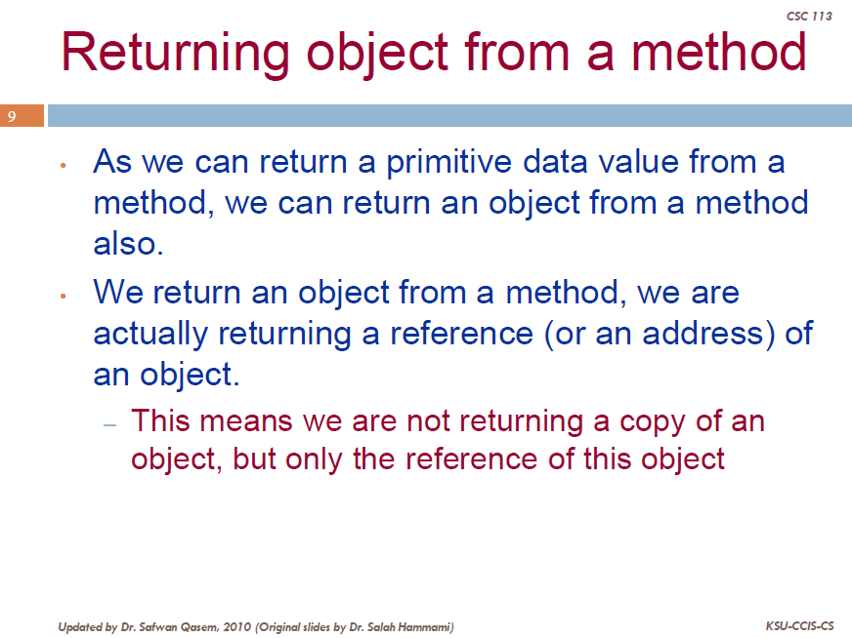

Slide 14
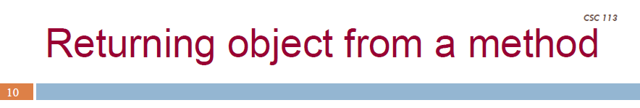

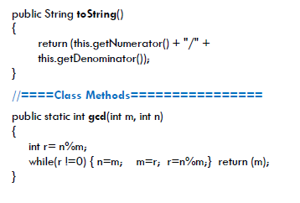

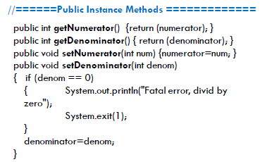
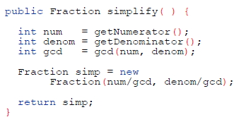


Slide 15
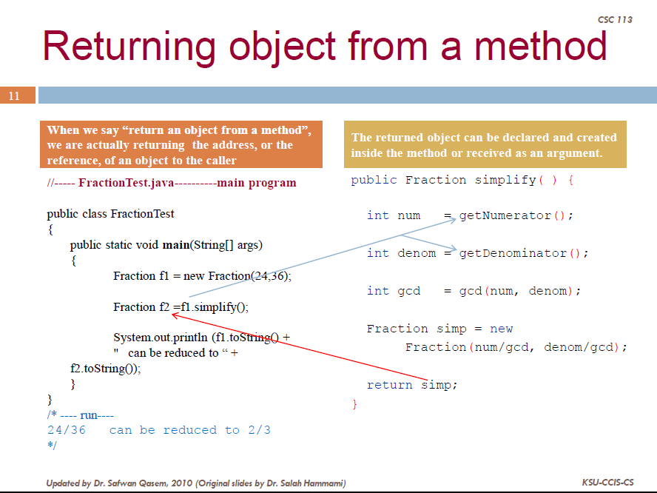

Slide 16
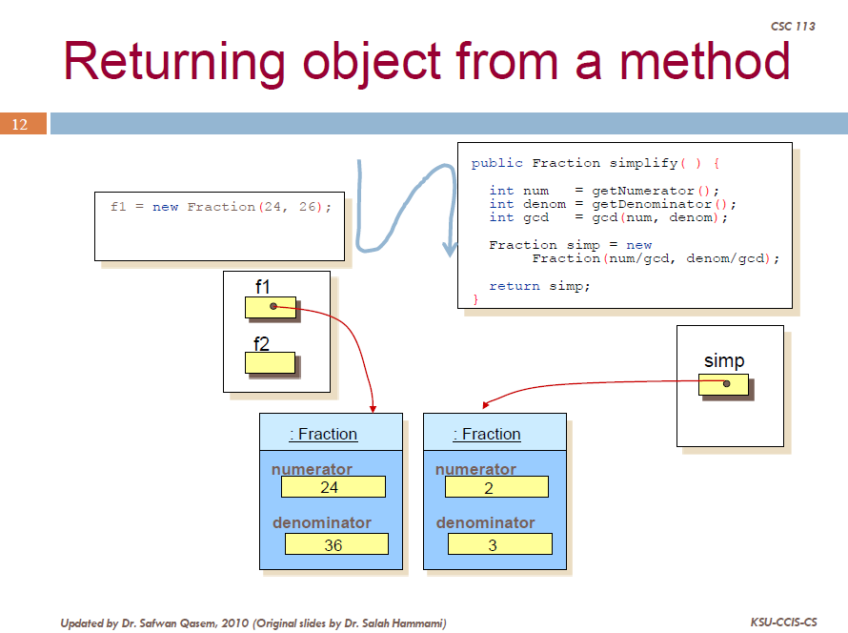
36)

Slide 17
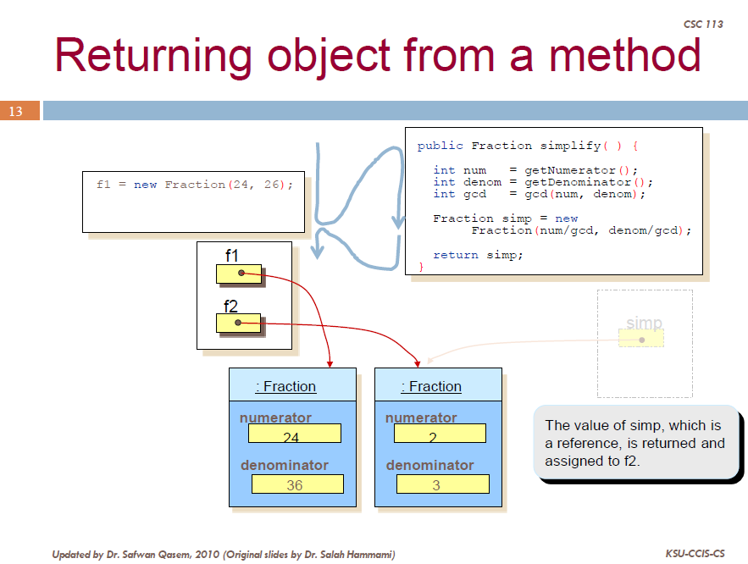
36)

Slide 18
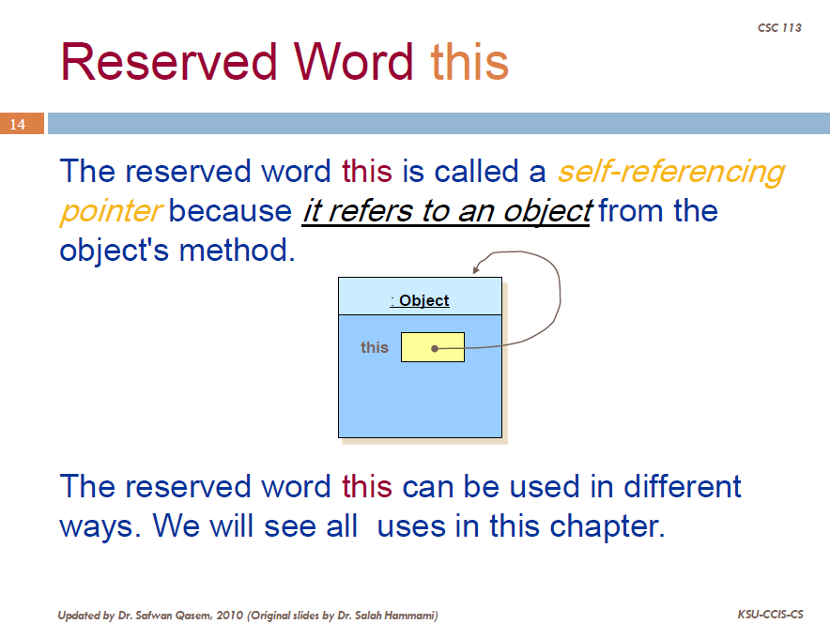

Slide 19
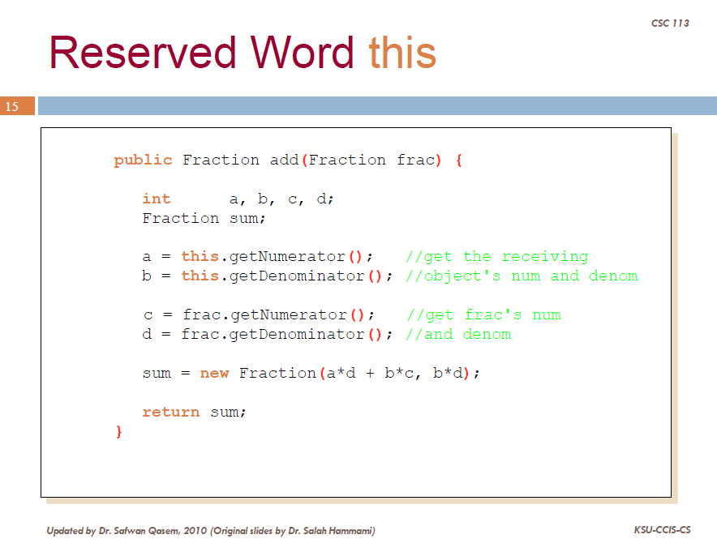

Slide 20
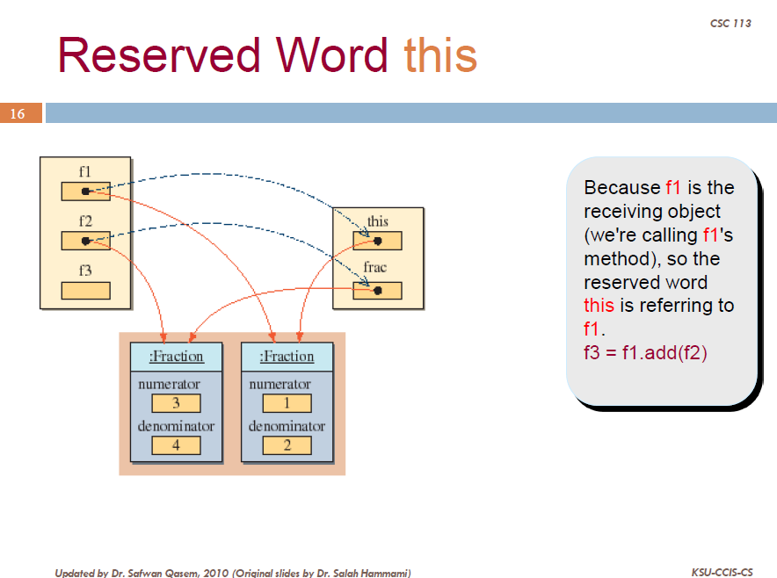

Slide 21
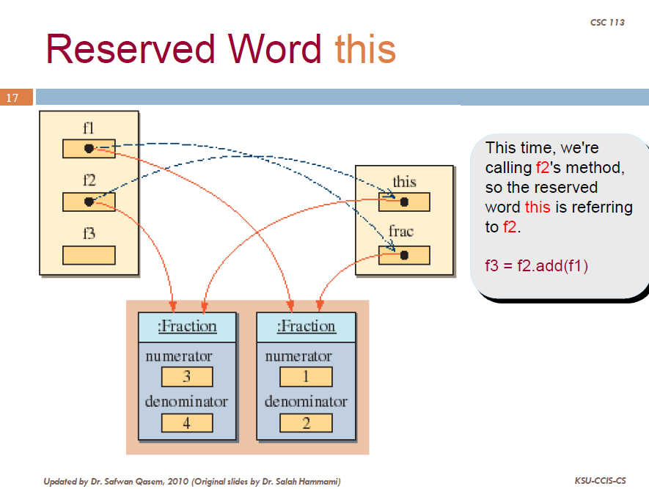

Slide 22
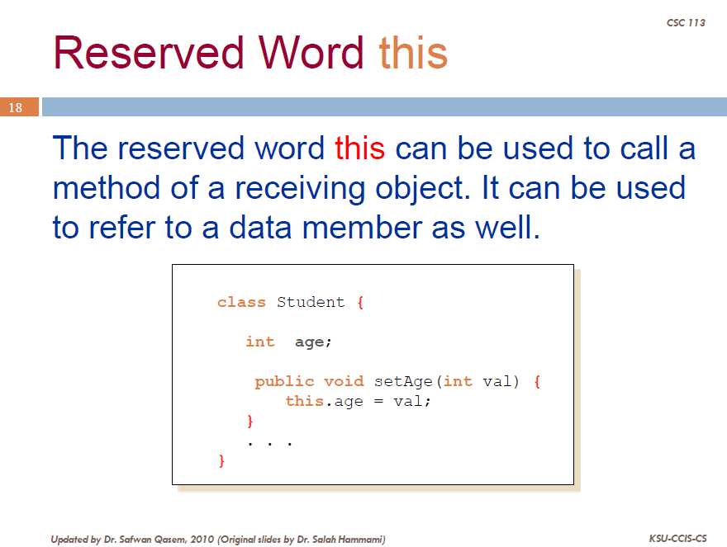

Slide 23
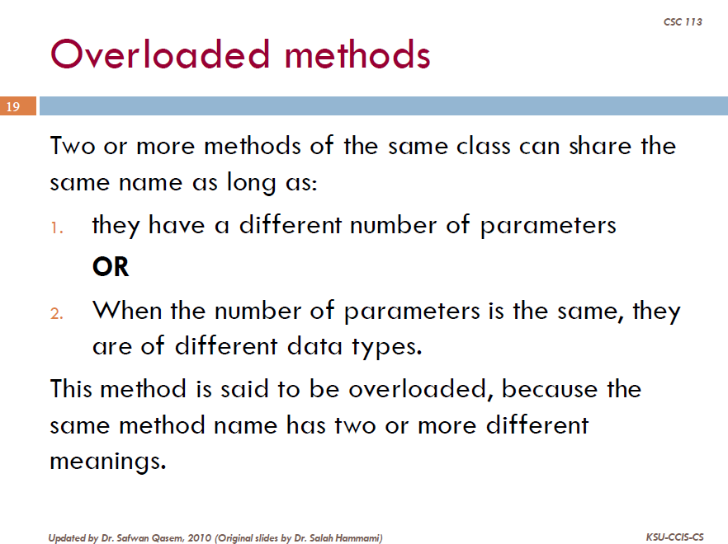

Slide 24
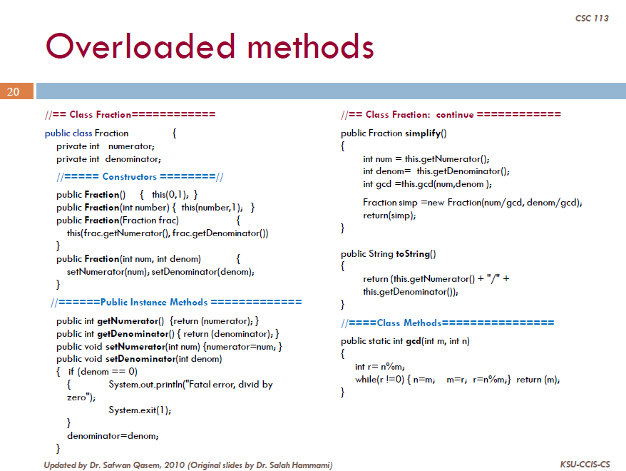
//call to constructor
//call to constructor
Notes:
this(...) - Calls another constructor in same class. Often a constructor with few parameters will call a constructor with more parameters, giving default values for the missing parameters. Use this to call other constructors in the same class.

Slide 25
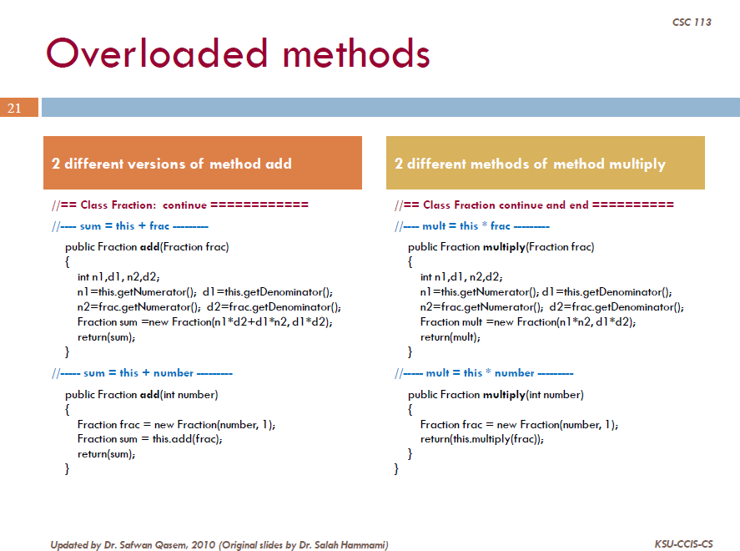

Slide 26
